Slide 1

Sankhyana Consultancy Services Pvt. Ltd.
Data Driven Decision Science
Convolutional Neural Network

Slide 2
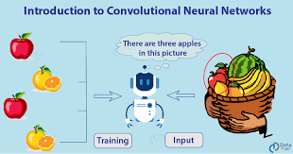
Introducing CNN
Convolutional Neural Networks (CNNs) are a class of deep neural networks specifically designed for processing structured grid data, such as images and video.
CNNs have revolutionized computer vision tasks by efficiently capturing spatial hierarchies and local patterns in data.
They are widely used for image classification, object detection, facial recognition, and various other visual task. s

Slide 3
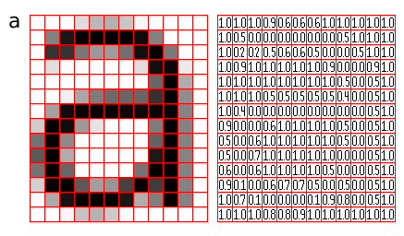
A Convolutional Neural Network, also known as CNN or ConvNet, is a class of neural networks that specializes in processing data that has a grid-like topology, such as an image.
A digital image is a binary representation of visual data. It contains a series of pixels arranged in a grid-like fashion that contains pixel values to denote how bright and what color each pixel should be. .

Slide 4
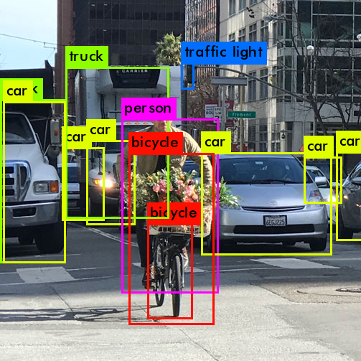
CNN IN OBJECT DETECTION

Slide 5
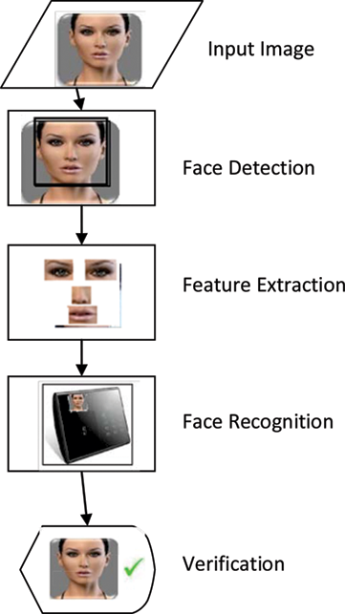
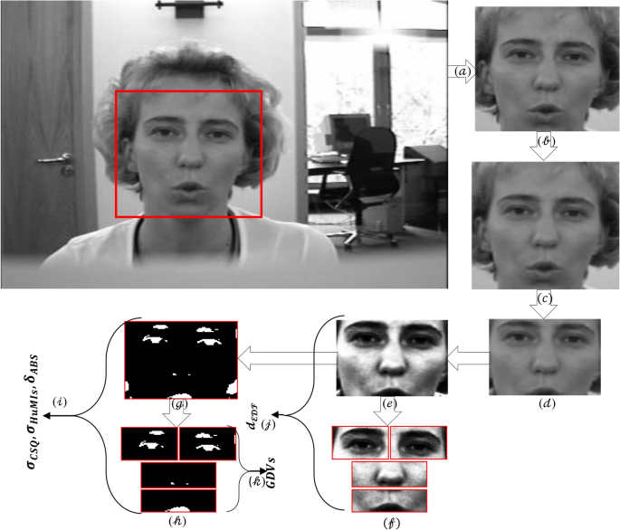
CNN IN FACE RECOGNITION

Slide 6
Why CNN
CNNs are a subset of deep learning, and understanding them provides a foundational understanding of deep neural networks, which are increasingly prevalent in various data science applications.
As CNNs continue to evolve, staying informed about the latest advancements in this field is essential for data scientists to remain competitive and contribute to cutting-edge projects.
CNNs are widely used for image classification tasks, such as identifying and categorizing objects within images. This is applicable in fields like e-commerce, medical imaging, and entertainment.
CNNs are fundamental to object detection and recognition, critical in applications like retail (automated checkout), security (surveillance systems), and industrial automation.
Including CNNs in a data science course ensures that students are equipped with the skills and knowledge needed to tackle contemporary challenges and leverage the full potential of data, especially in domains where visual information is critical.

Slide 7
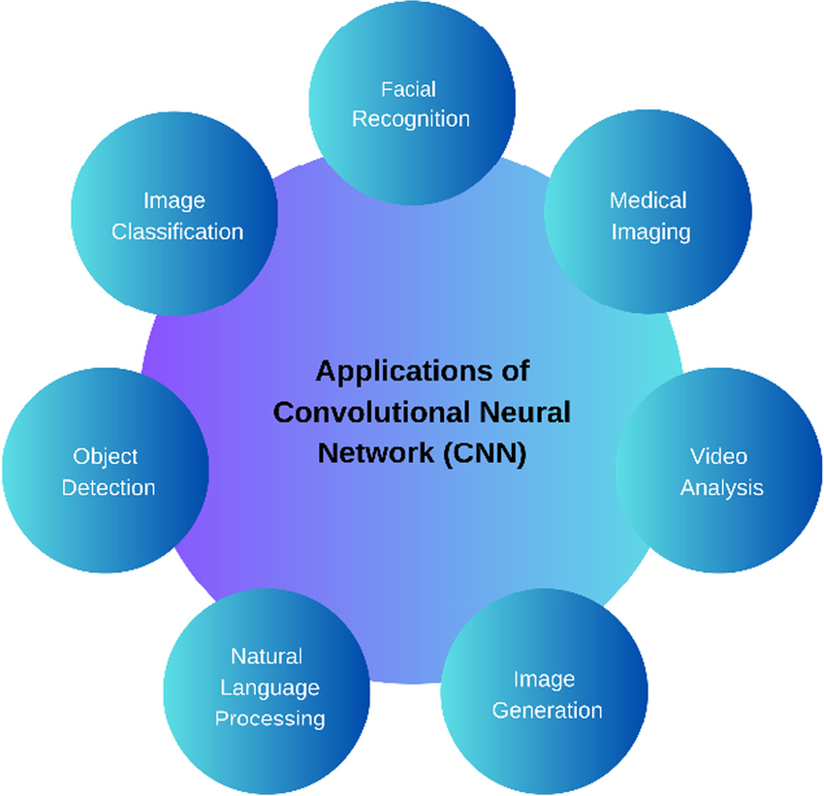
Industry Use:

Slide 8
What Is Convolutional Operations
Convolutional Operations
Convolution operations can operate both on input images and activation maps obtained from other convolution operations. However, as we build more layers, the aim is to learn more and more complex features.
Convolution is a mathematical operation on two Functions (f and g) that produces a third function ( f * g ) that expresses how the shape of one is modified by the other.
The term convolution refers to both the result function and to the process of computing it.
It is defined as the integral of the product of the two functions after one is reflected about the y-axis and shifted. The choice of which function is reflected and shifted before the integral does not change the integral result (see commutativity).
The integral is evaluated for all values of shift, producing the convolution function.

Slide 9
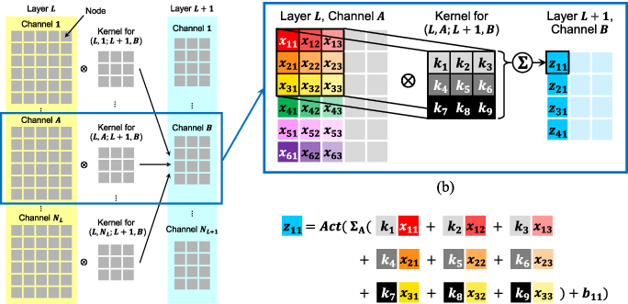
Workflow of Convolutional Operation:

Slide 10
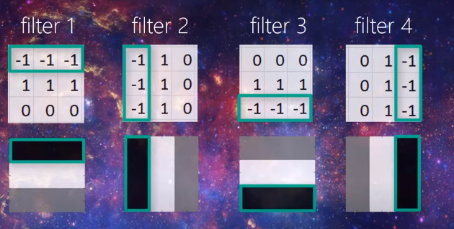
Workflow of Convolutional Operation:

Slide 11

Understanding of convolution operation
What is kernel/filter?
The kernel is a rectangular small matrix, which slides over the image from left to right and top to bottom.

Slide 12
What is stride?
The number of pixels we slide over the input image by the kernel is called a stride.

Slide 13
The convolution operation is the process of implying a combination of two functions that produce the third function as a result, employing filters across the entire input image allows the filter to discover that feature of the image. Which is also called a feature map.
Let’s understand through a simple analogy of a Jigsaw puzzle. A jigsaw puzzle is a perfect example of a convolutional operation.
In a jigsaw puzzle, each piece has a portion of an image that reveals something about the complete picture when assembled.
Like a jigsaw puzzle in convolutional networks, multiple filters are taken to slice through the image and map them one by one and learn different portions of an input image.

Slide 14
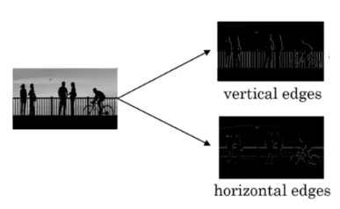
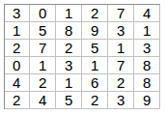
Edge Detection Example
As you can see, there are many vertical and horizontal edges in the image. The first thing to do is to detect these edges:
But how do we detect these edges? To illustrate this, let’s take a 6 X 6 grayscale image (i.e. only one channel):

Slide 15
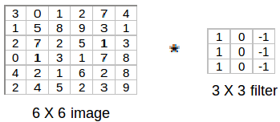
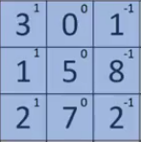
Next, we convolve this 6 X 6 matrix with a 3 X 3 filter:
After the convolution, we will get a 4 X 4 image. The first element of the 4 X 4 matrix will be calculated as:

Slide 16
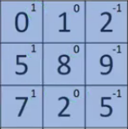
So, we take the first 3 X 3 matrix from the 6 X 6 image and multiply it with the filter. Now, the first element of the 4 X 4 output will be the sum of the element-wise product of these values, i.e. 3*1 + 0 + 1*-1 + 1*1 + 5*0 + 8*-1 + 2*1 + 7*0 + 2*-1 = -5. To calculate the second element of the 4 X 4 output, we will shift our filter one step towards the right and again get the sum of the element-wise product:

Slide 17

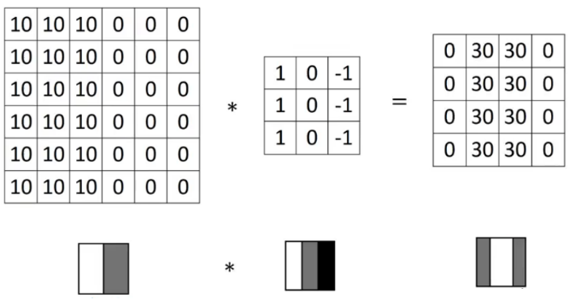
Similarly, we will convolve over the entire image and get a 4 X 4 output:
So, convolving a 6 X 6 input with a 3 X 3 filter gave us an output of 4 X 4.

Slide 18
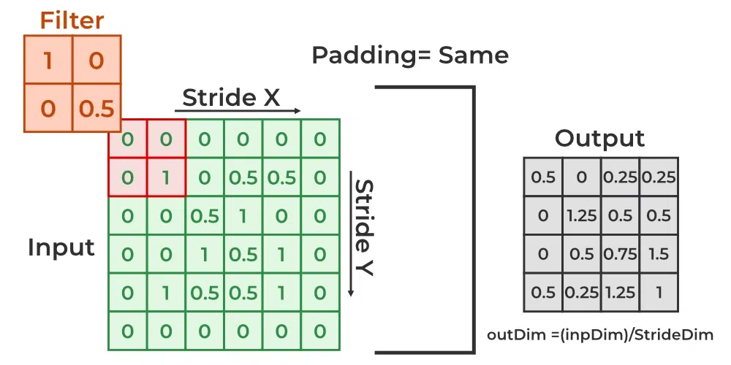
Padding:
In convolutional neural networks (CNNs), padding is the process of adding extra pixels to an image before applying convolution. Padding helps the network retain more spatial information. It also helps the kernel (feature extractor) to visit pixels of the image around the corners more times to extract important features for better learning

Slide 19
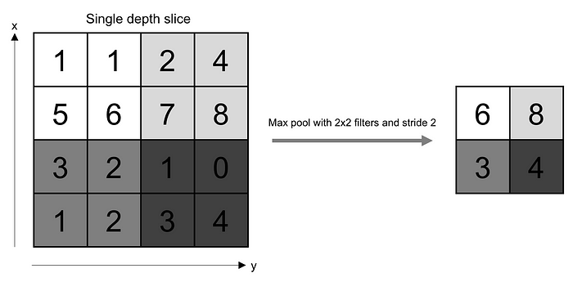
Pooling Layer
The pooling layer replaces the output of the network at certain locations by deriving a summary statistic of the nearby outputs. This helps in reducing the spatial size of the representation, which decreases the required amount of computation and weights. The pooling operation is processed on every slice of the representation individually.
There are several pooling functions such as the average of the rectangular neighborhood, L2 norm of the rectangular neighborhood, and a weighted average based on the distance from the central pixel. However, the most popular process is max pooling, which reports the maximum output from the neighborhood

Slide 20
Fully Connected Layer
The Fully Connected (FC) layer consists of the weights and biases along with the neurons and is used to connect the neurons between two different layers. These layers are usually placed before the output layer and form the last few layers of a CNN Architecture.
In this, the input image from the previous layers are flattened and fed to the FC layer. The flattened vector then undergoes few more FC layers where the mathematical functions operations usually take place. In this stage, the classification process begins to take place. The reason two layers are connected is that two fully connected layers will perform better than a single connected layer. These layers in CNN reduce the human supervision

Slide 21
Activation Functions:
Finally, one of the most important parameters of the CNN model is the activation function.
They are used to learn and approximate any kind of continuous and complex relationship between variables of the network. In simple words, it decides which information of the model should fire in the forward direction and which ones should not at the end of the network.
It adds non-linearity to the network. There are several commonly used activation functions such as the ReLU, SoftMax, tanH and the Sigmoid functions. Each of these functions have a specific usage.
For a binary classification CNN model, sigmoid and SoftMax functions are preferred an for a multi-class classification, generally SoftMax us used. In simple terms, activation functions in a CNN model determine whether a neuron should be activated or not.
It decides whether the input to the work is important or not to predict using mathematical operations.

Slide 22
